Slide 1



Joint work with the Coinbase cryptography team (and others)
Arash Afshar
Yi-Hsiu Chen
Samuel Ranellucci
Science of Blockchain Conference, August 2024
MPC for Custody (and more) at Coinbase
Yehuda Lindell
Head of Cryptography at Coinbase

Slide 2
In this talk, we will describe CoreKMS Vault, a new key signing service at Coinbase
Our description will not include exact deployment details, but rather the system and its capabilities
Not all details are included, due to time constraints
This talk contains a description of technology that Coinbase has available. Internal deployment of this technology may change over time.

Slide 3

Challenges of Asset Protection
3

Slide 4
Offline and Online Systems
Offline – an air-gapped system that holds the keys and signs
Can be very high security
But security is not immediate:
How are transactions imported and signatures exported?
How is the physical environment protected and controlled?
Challenges regarding time to sign
Online – key held in online server
Security challenges – an online machine with a highly lucratice target
Security risks: supply chain attack, insider access, zero days, etc.
Not suitable for large amounts
Immediate response time

Slide 5
Single Points of Failure (Attack)
With such an extremely lucrative target, any single point of attack is dangerous
Offline systems can be made very secure, but can also be a single point of failure (with a single place holding the key)
Can be mitigated well (multiple people and physical access controls)
Good mitigations can impact transaction signing time
Offline systems work extremely well for infrequent operations (e.g., key generation ceremonies, infrequent transfers of funds out of freeze, etc.) but less so for ongoing operations

Slide 6
CoreKMS Vault
6

Slide 7
Design Principles
Flexibility
Different products (custody, exchange, non-custodial, etc.)
Different security tradeoffs and response speed
Security
No single environment with key access
Different entities with strong separation between them during entire lifecycle
Defense in depth throughout

Slide 8
Underlying Technology
We use MPC to obtain strong separation and flexibility
Asset keys are shared amongst entities, and never brought together, throughout their entire lifecycle
Backup is publicly verifiable and highly protected from loss and theft

Slide 9
CoreKMS Vault Entity Types
Offline environment
Human approvers
MPC servers

Slide 10
Entity Types
Offline environment
An offline machine + a separate store of key shares
Physically secure location with strict access limitations
The offline environment holds only one share of the key

Slide 11
Entity Types
Human approvers
Devices held by human operators (e.g., laptop, mobile)
Hold shares of a threshold decryption key (e.g., TDH2 by Shoup-Gennaro)
Generated via MPC at vault generation
One share of each asset-key is encrypted under the threshold encryption public key
Access structure defines quorum
System supports advanced access structures like (3-out-of-5) AND (4-out-of-10); any tree with AND, OR and threshold nodes
Human approver operations must be asynchronous (i.e., do not need to be online at the same time)

Slide 12
Entity Types
Online MPC servers
Servers who each hold their database of key shares
Each server holds its own share
Always online, and can interact with each other over multiple rounds

Slide 13
Entity Types – Security and Rationale
Strong separation with different types of entities
Infrastructure for all three environments is completely different
Offline environment – without participation there isn’t enough key material to sign online
Human approvers disconnected also means that there isn’t enough key material to sign online
MPC servers can be completely locked down in the server infrastructure (and can also be separated, if desired)
Different instantiations can have different entity types, and different number of entities in each type

Slide 14
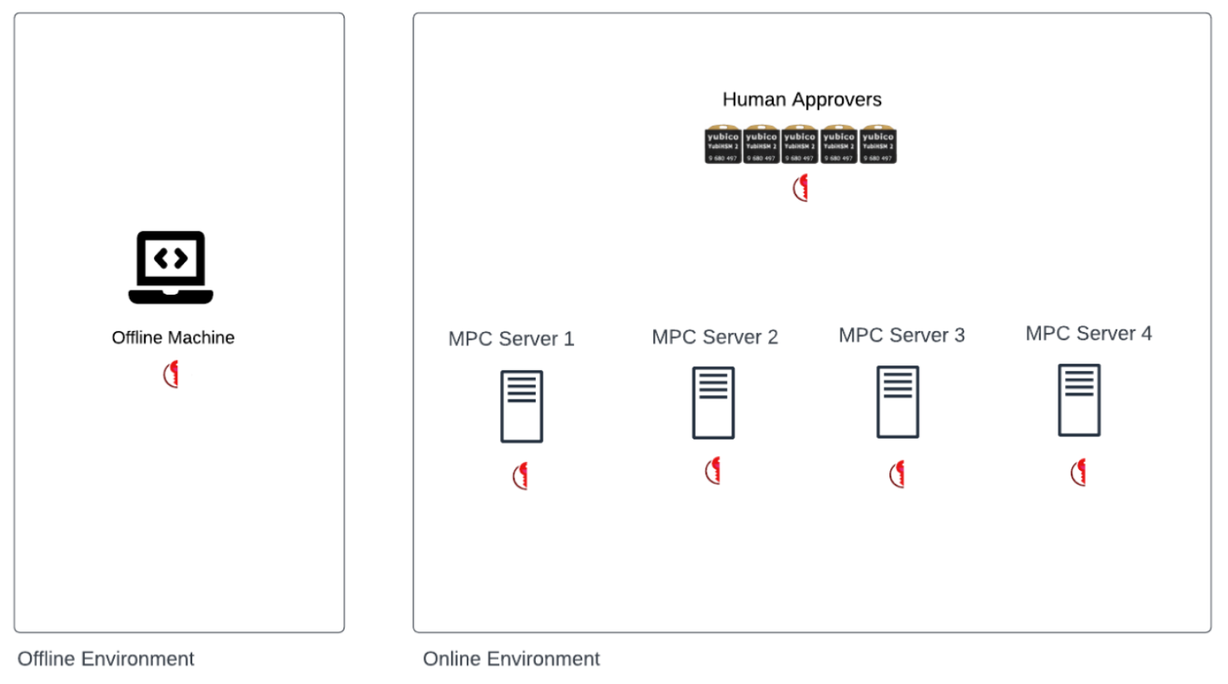

Slide 15
Operations
Key generation and backup
Signing
Approver administration

Slide 16
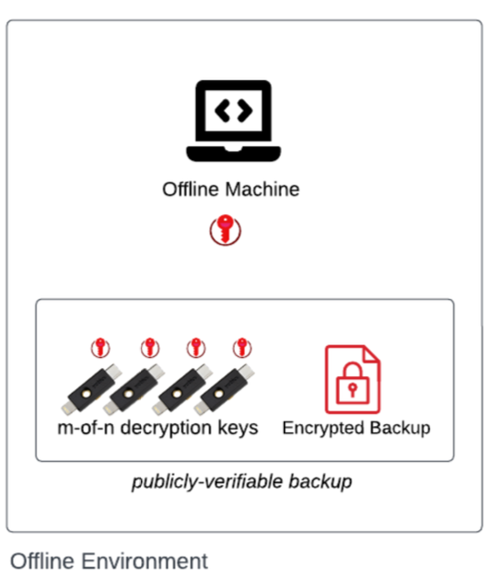
Key Generation and Backup
System with offline element
Key generation ceremony in special offline environment (more secure than regular one)
Encrypt each entities’ share under given public keys (offline signing environment, approvers, each MPC server)
System without offline element
Use MPC protocol to generate key shares
At key generation, all shares are backed up using publicly-verifiable backup, with a quorum of backup entities required for any share

Slide 17
Signing
Step 1 – offline environment
Receives transaction request, loads key share
Subshares key share to all MPC servers plus human approvers
Encrypt under server public keys and approver threshold key
This subsharing is fresh and different in every transaction

Slide 18
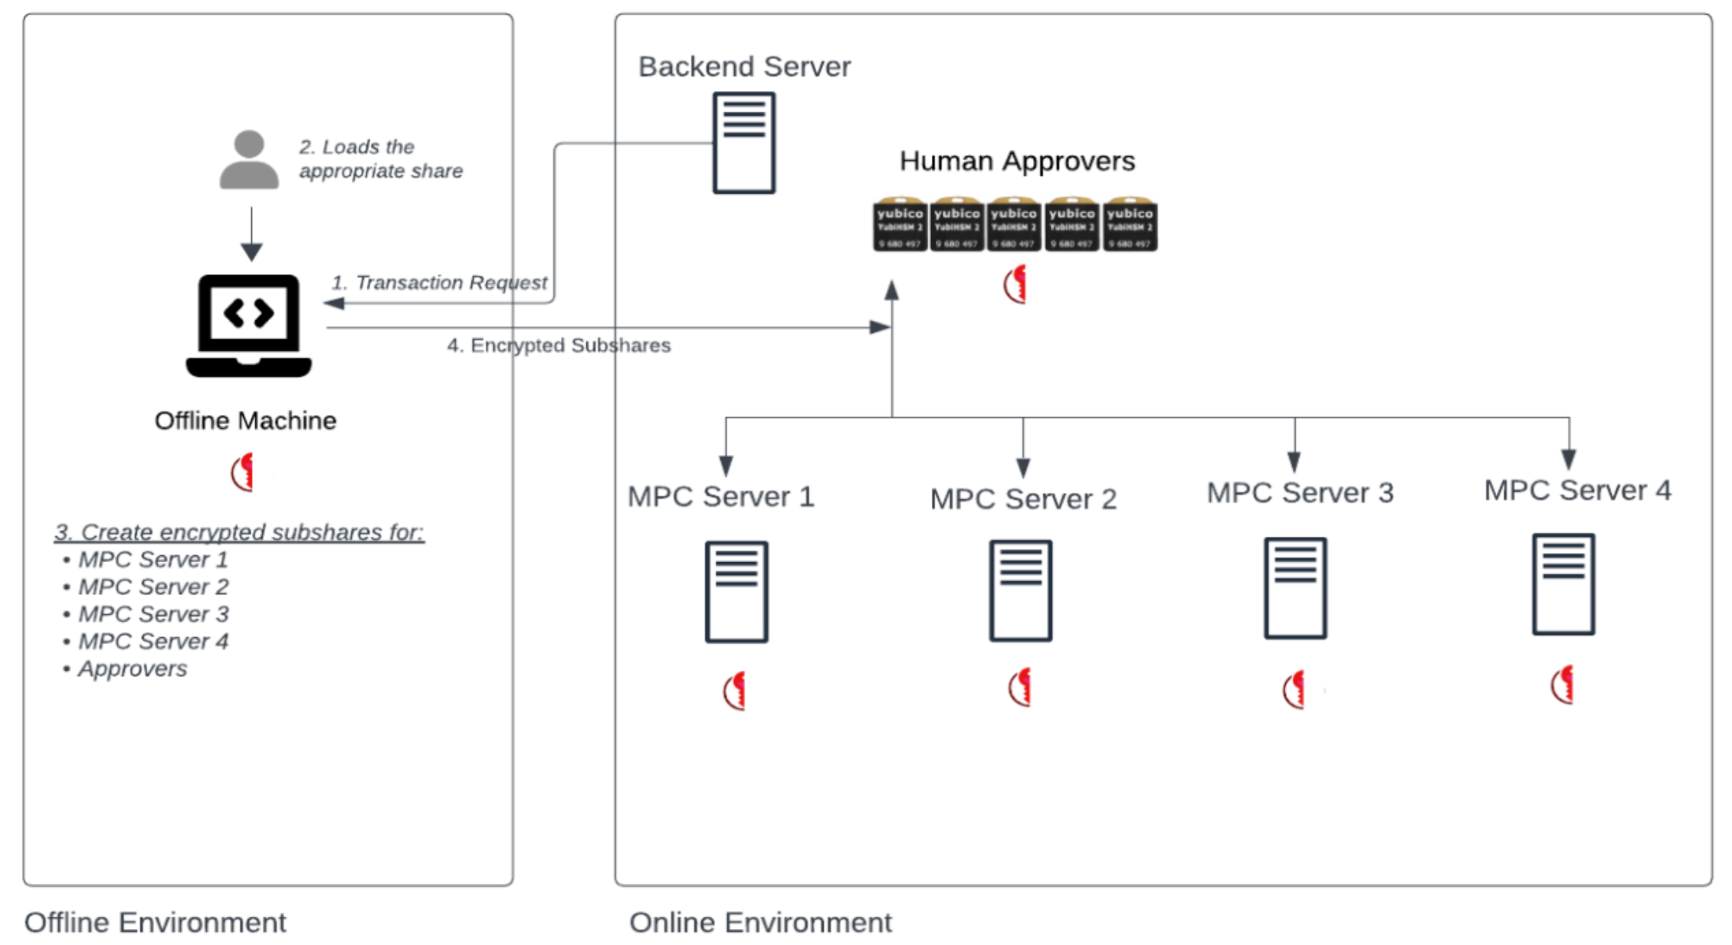

Slide 19
Signing
Step 2 – each human approver up to last in quorum
Receives transaction request, verifies transaction attestations
Generates partial decryption of approver key share and offline subshare
Partial decryptions are re-encrypted under approver public keys
Last approver in the quorum
Obtains the partial decryptions and finalizes to get shares (approver share and offline subshare)
Adds them together

Slide 20
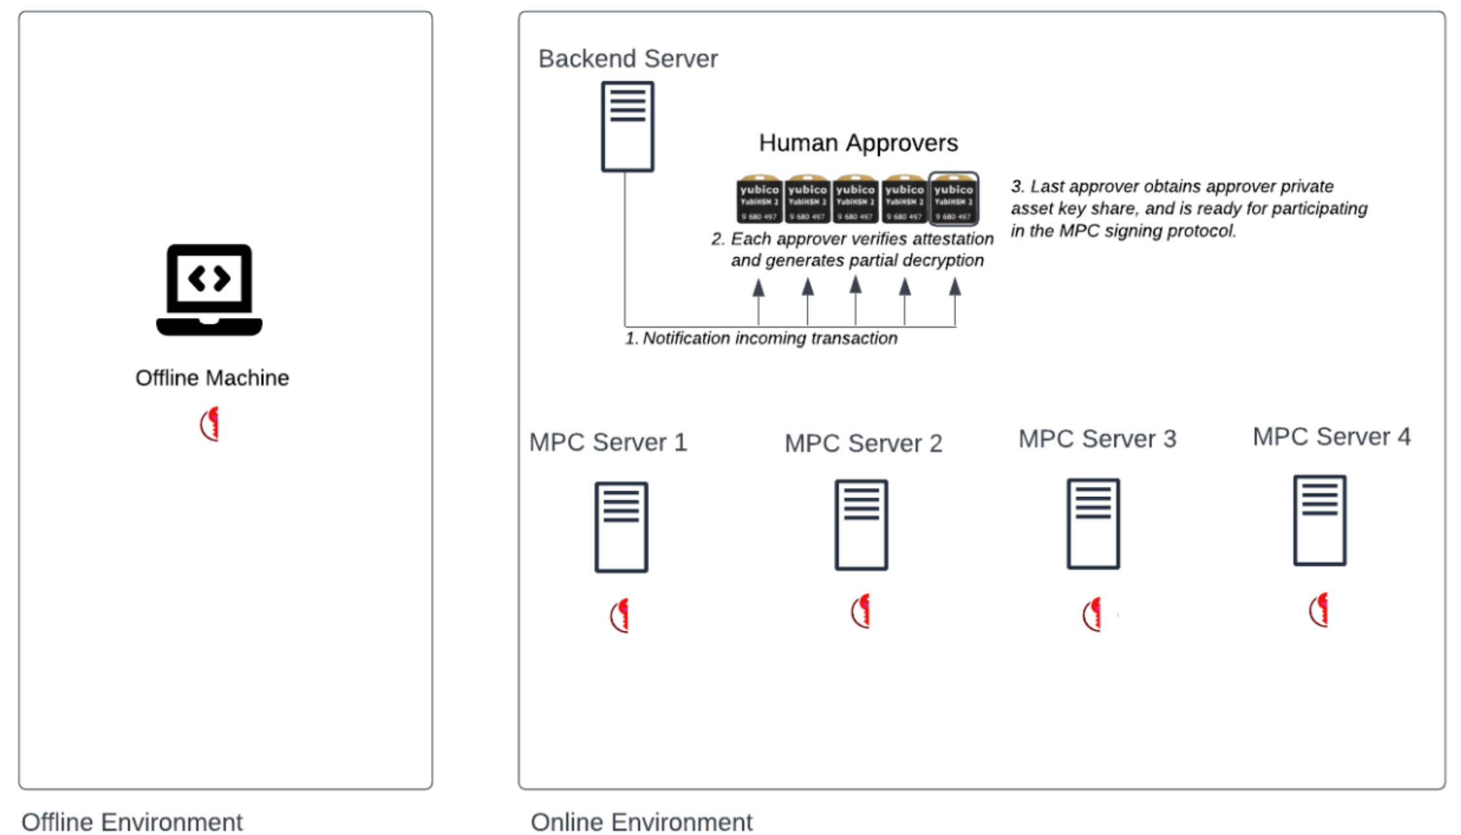

Slide 21
Signing
Step 3 – MPC Signing
Each MPC server receives offline environment’s subshare and adds to its own (also verifying all attestations)
MPC servers and last approver “agree” on the participants and the sharing (verify that the sum of all “public shares” is correct)
MPC servers and last approver run MPC to sign
MPC servers and last approver refresh the sharing of the asset key (excluding the offline share)
All state information is erased

Slide 22
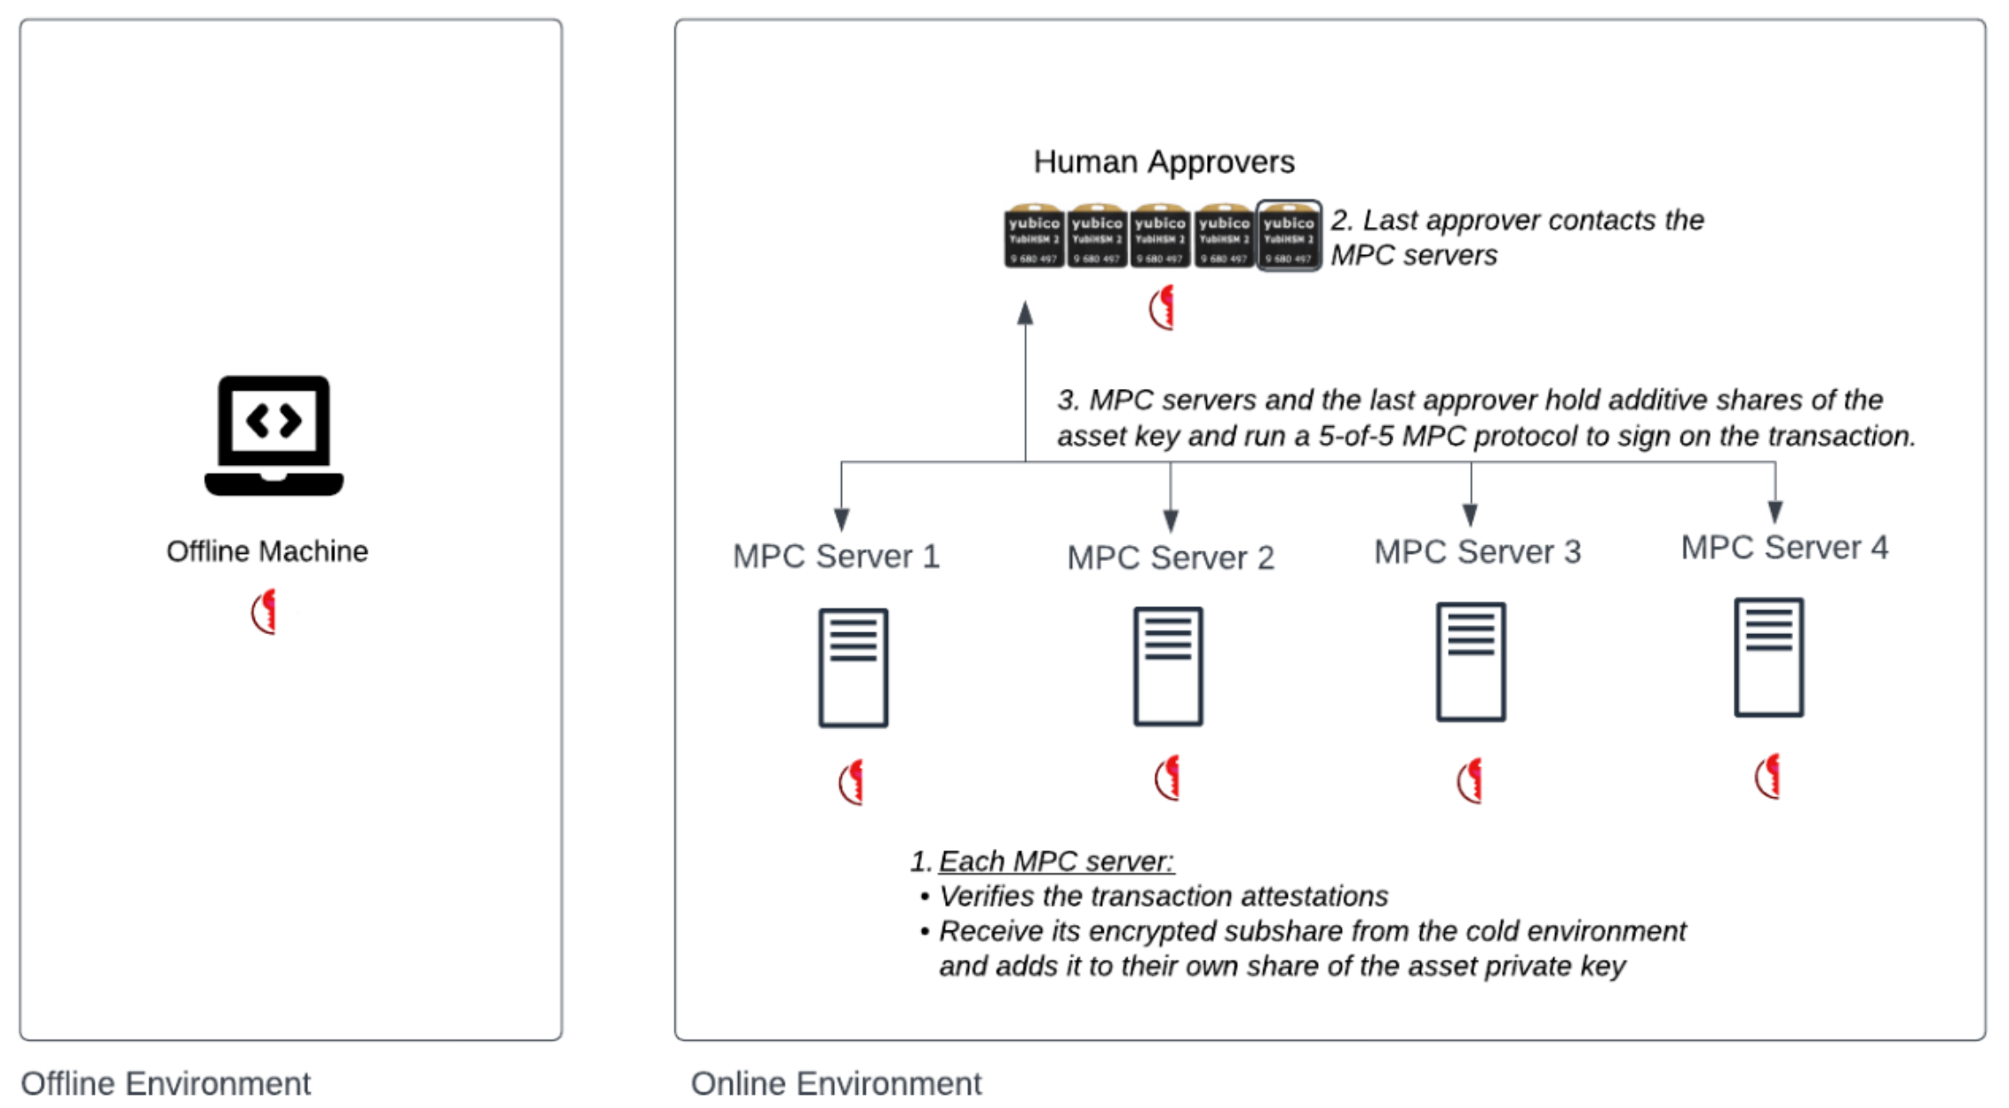

Slide 23
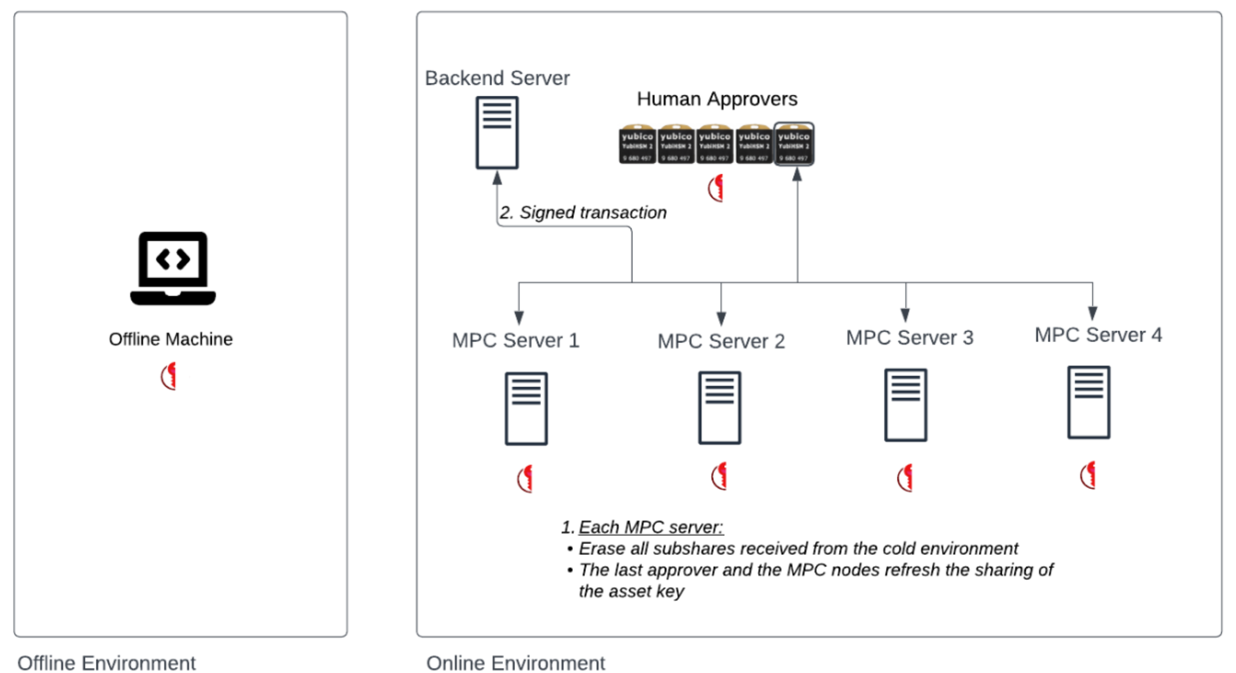

Slide 24
Approver Administration
System also includes protocols for approver administration
Add approver
Remove approver
Change approver quorum structure
Refresh approver threshold decryption key
All of the above via MPC
All operations require signed admin quorum approval

Slide 25
Properties
25

Slide 26
Security
A key cannot be brought to signing without approval from offline environment, a quorum of approvers, and all MPC servers
Attestation verifications reduce risk of fraudulent transactions
Multiple attestation services can also be used
This is crucial for preventing key misuse
When using an offline environment, before being used, a key is never online in any form
No single point of failure / attack
Strong separation between machine types and machines
Makes it very hard to simultaneously corrupt all MPC servers and approvers

Slide 27
Achieving Flexibility and Speed
Can be deployed in multiple configurations and locations
Important for MiCA compliance
Configurations
All entities – offline, human approvers, MPC servers:
The number of human approvers, the access structure and where they are located can change, depending on the product and its needs
MPC servers and human approvers:
Same flow as above, but without offline
Faster than above, but still has element that can be disconnected
MPC servers only:
Fast response, always online; much more secure than classic online systems

Slide 28
Defense in Depth
All servers are heavily locked down
Approver shares are encrypted with device secure enclave and external YubiHSMs
Zero-trust approach to all devices in the system
Controls around offline environment, approver operators, etc.
And much more

Slide 29
Thank You
29

